Slide 1

Academic Session 2025-26
ODD Semester Jul-Dec 2025
UNIVERSITY INSTITUTE OF ENGINEERING
COMPUTER SCIENCE ENGINEERING
Bachelor of Engineering
Semester: 6th
Design and Analysis of Algorithms
(23CSH-301/ITH-301)
Unit No. 1 Chapter No. 2 Lecture No.10
Topic : AVL Trees
Richa Dhiman E11307 Assistant Professor

Slide 2
1
Learning Objectives & Outcomes
Objective:
To understand the meaning of Tree
To Study its Hierarchical Structure .
To analyze its Parent and Child node structure.
Outcome:
Student will understand
Tree and operations performed on tree
Different Tree Types

Slide 3
2
AVL Tree
AVL tree is a self-balancing Binary Search Tree (BST) where the difference between heights of left and right subtrees cannot be more than one for all nodes.
Why AVL Trees?
Most of the BST operations (e.g., search, max, min, insert, delete.. etc) take O(h) time where h is the height of the BST. The cost of these operations may become O(n) for a skewed Binary tree. If we make sure that height of the tree remains O(Logn) after every insertion and deletion, then we can guarantee an upper bound of O(Logn) for all these operations

Slide 4
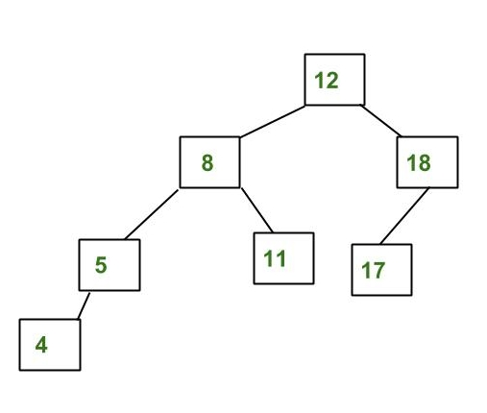
3
Example
The above tree is AVL because differences between heights of left and right subtrees for every node is less than or equal to 1.

Slide 5
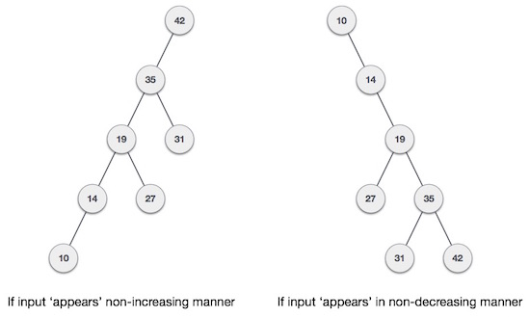
AVL tree is a self-balancing Binary Search Tree (BST) where the difference between heights of left and right subtrees cannot be more than one for all nodes.
What if the input to binary search tree comes in a sorted (ascending or descending) manner? It will then look like this −
4

Slide 6
5
It is observed that BST's worst-case performance is closest to linear search algorithms, that is Ο(n). In real-time data, we cannot predict data pattern and their frequencies. So, a need arises to balance out the existing BST.
Named after their inventor Adelson, Velski & Landis, AVL trees are height balancing binary search tree. AVL tree checks the height of the left and the right sub-trees and assures that the difference is not more than 1. This difference is called the Balance Factor.

Slide 7
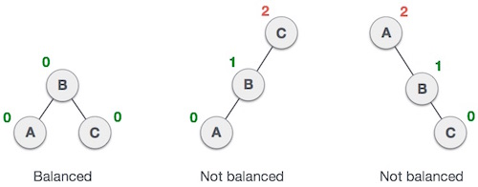
6
Here we see that the first tree is balanced and the next two trees are not balanced
In the second tree, the left subtree of C has height 2 and the right subtree has height 0, so the difference is 2. In the third tree, the right subtree of A has height 2 and the left is missing, so it is 0, and the difference is 2 again. AVL tree permits difference (balance factor) to be only 1.
BalanceFactor = height(left-sutree) − height(right-sutree)
If the difference in the height of left and right sub-trees is more than 1, the tree is balanced using some rotation techniques.

Slide 8
7
AVL Rotations
To balance itself, an AVL tree may perform the following four kinds of rotations
Left rotation
Right rotation
Left-Right rotation
Right-Left rotation

Slide 9
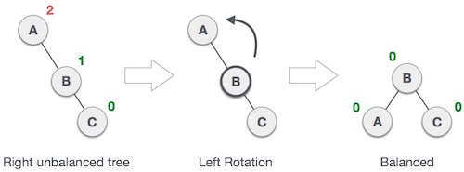
7
Left Rotation
If a tree becomes unbalanced, when a node is inserted into the right subtree of the right subtree, then we perform a single left rotation −
In our example, node A has become unbalanced as a node is inserted in the right subtree of A's right subtree. We perform the left rotation by making A the left-subtree of B.

Slide 10
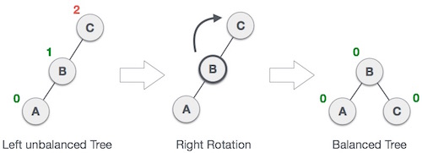
7
Right Rotation
AVL tree may become unbalanced, if a node is inserted in the left subtree of the left subtree. The tree then needs a right rotation.
As depicted, the unbalanced node becomes the right child of its left child by performing a right rotation.

Slide 11
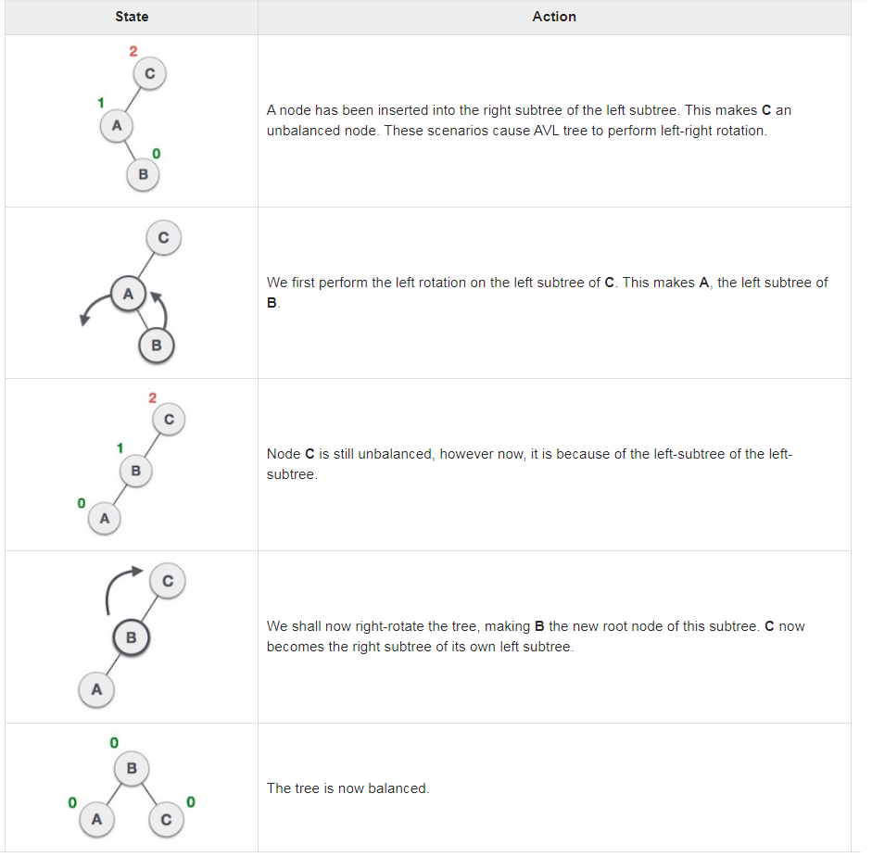
7

Slide 12
8
Right-Left Rotation
The second type of double rotation is Right-Left Rotation. It is a combination of right rotation followed by left rotation.

Slide 13
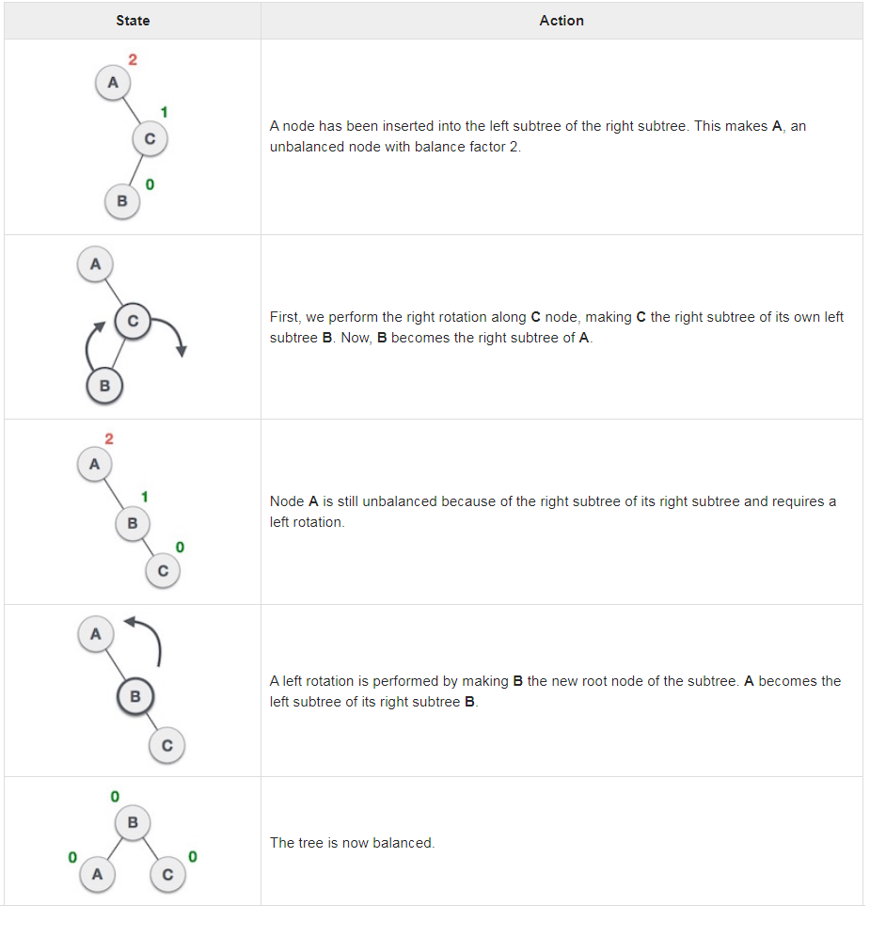
9

Slide 14
10
Left-Right Rotation
Double rotations are slightly complex version of already explained versions of rotations. To understand them better, we should take note of each action performed while rotation. Let's first check how to perform Left-Right rotation. A left-right rotation is a combination of left rotation followed by right rotation.

Slide 15
11
Red black tree
Red-Black Tree is a self-balancing Binary Search Tree (BST) where every node follows following rules:
1) Every node has a color either red or black.
2) Root of tree is always black.
3) There are no two adjacent red nodes (A red node cannot have a red parent or red child).
4) Every path from a node (including root) to any of its descendant NULL node has the same number of black nodes.

Slide 16
12
Why Red black tree?
Most of the BST operations (e.g., search, max, min, insert, delete.. etc) take O(h) time where h is the height of the BST. The cost of these operations may become O(n) for a skewed Binary tree. If we make sure that height of the tree remains O(Logn) after every insertion and deletion, then we can guarantee an upper bound of O(Logn) for all these operations. The height of a Red-Black tree is always O(Logn) where n is the number of nodes in the tree.

Slide 17
Summary
17
Types of Trees
AVL trees
Red Black tree Introduction

Slide 18
18
Next Lecture
- Hashing

Slide 19
19
Quiz
What does AVL in AVL Tree stand for? A) Adelson-Velsky and Landis B) Automatic Variable Listing C) Advanced Vector Level D) None of the above
Which condition must be satisfied in an AVL Tree? A) All nodes must be complete B) Tree must be balanced after every insertion and deletion C) Tree should not contain duplicate values D) All nodes must be leaf nodes

Slide 20
20
References/ Articles/ Videos
Text books:
Cormen, Leiserson, Rivest, Stein, “Introduction to Algorithms”, Prentice Hall of India, 3rd edition 2012. problem, Graph coloring.
Horowitz, Sahni and Rajasekaran, “Fundamentals of ComputerAlgorithms”, University Press (India), 2nd edition
Websites:
https://www.tutorialride.com/data-structures/trees-in-data-structure.htm
https://www.geeksforgeeks.org/avl-tree-set-1-insertion/

Slide 21
21
Faculty-curated videos, NPTEL, Coursera, LinkedIn, or other relevant learning resources
https://onlinecourses.nptel.ac.in/noc23_cs96/preview
https://nptel.ac.in/courses/106106131
https://nptel.ac.in/courses/106106208
https://www.linkedin.com/learning/learning-algorithms

Slide 22
23
Class-Wise Feedback

Slide 23
24
Thank You
For queries
Email: richa.e11307@cumail.in

